Slide 1



global Academy of
Technology
Rajarajeshwari Nagar,Bengaluru-560098
Department of Electronics and Communication Engineering
Mini Project Phase-I (BECP24507)
Review-0 Presentation
On
“AI-Assisted Fault-Tolerant Artificial Nervous System forSoft Robotic Grippers”
Under The Guidance oF:
Dept.ECE
Asst.Prof. Kusuma H R
Presented By:
Yasmitha B R (1GA24EC234)
Vishal Kambli (1GA24EC226)
Veeresh (1GA24EC218)
Varun G R (1GA24EC215)
Batch Number:9

Slide 2
CONTENTS
Introduction
Problem Statement
Objectives
Features
Outcomes

Slide 3

INTRODUCTION
Sentinel Soft Gripper is an intelligent robotic gripper designed to pick and hold objects safely.
It uses soft and flexible fingers that can easily adjust to the shape and size of different objects.
The gripper has different sensors to check the finger movement, object contact, gripping force, and motor condition.
The sensor data is continuously collected and processed by a microcontroller such as ESP32.
The system checks the sensor readings to find out if any sensor is giving wrong, missing, or unusual values.
If a sensor problem is detected, Sentinel uses the information from the other sensors to identify which sensor is faulty.
The faulty sensor is then ignored or isolated, so its incorrect data does not affect the gripper.
This makes the gripper safer, more reliable, and capable of continuing its operation even when a sensor fails.

Slide 4
PROBLEM STATEMENT
Conventional robotic grippers rely on sensors for information about position, contact, force and actuator condition.
A sensor may become faulty because of disconnection, damage, calibration error, noise, drift or environmental conditions.
An incorrect sensor value can cause the controller to make an incorrect gripping decision.
Excessive gripping force can damage fragile objects, while insufficient force can cause the object to slip or fall.
A single faulty sensor can reduce the reliability of the complete gripping system.
Conventional systems may respond to sensor failure by stopping operation or generating a fault condition.
However, the remaining healthy sensors may still contain sufficient information about the gripper's state.
Therefore, simply shutting down the gripper after a sensor failure can result in unnecessary downtime and reduced productivity.

Slide 5
OBJECTIVES
To design and develop a soft robotic gripper for adaptive object handling.
To integrate multiple sensors for real-time monitoring of gripping conditions.
To detect abnormal, inconsistent and faulty sensor readings.
To identify and isolate the faulty sensor from the control system.
To use sensor fusion for reliable estimation of the gripper's state.

Slide 6
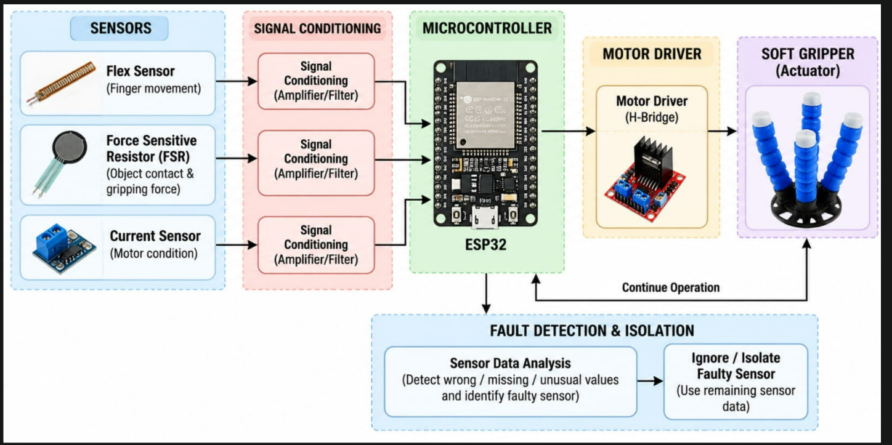
Features
Soft & Flexible Gripper – Flexible fingers/tentacles adapt to different object shapes.
Adaptive Grip – Automatically adjusts gripping force according to the object
Slip Detection – Detects when the object begins to slip.
Real-Time Monitoring – Displays sensor values and system status on a dashboard.
Wireless Communication – ESP32 can transmit data through Wi-Fi/Bluetooth.
Closed-Loop Control – Automatically changes grip based on sensor feedback..

Slide 7
OUTCOMES
Fault detection accuracy
Fault isolation accuracy
Position RMSE
Reconstruction RMSE
Grasp success rate
Average recovery time

Slide 8
THANK YOU

